Slide 1
Sets

Slide 2
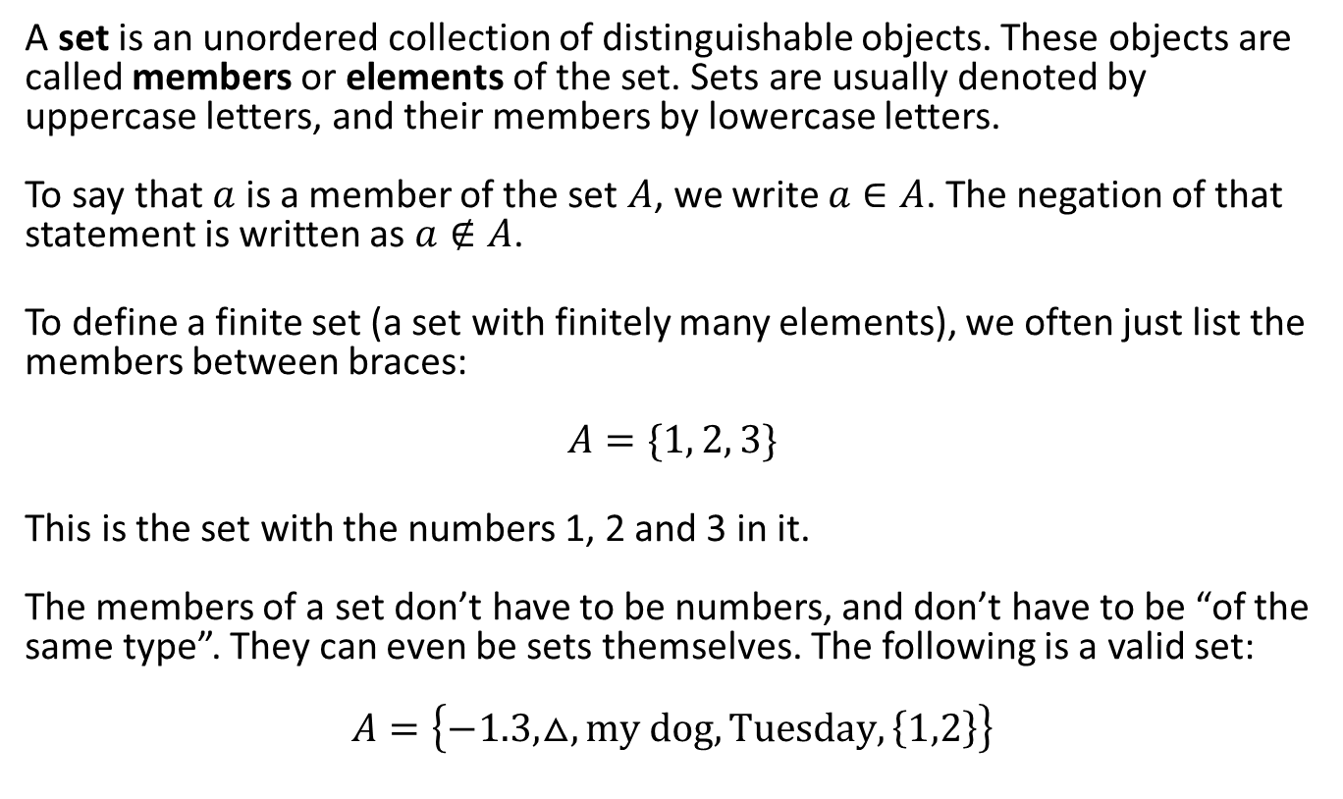
Definitions and Vocabulary of Sets
A set is an unordered collection of distinguishable objects. These objects are called members or elements of the set. Sets are usually denoted by uppercase letters, and their members by lowercase letters. To say that $a$ is a member of the set $A$, we write $a∈A$. The negation of that statement is written as $a∉A$.
To define a finite set (a set with finitely many elements), we often just list the members between braces: $$A=\{1, 2, 3\}$$
This is the set with the numbers 1, 2 and 3 in it. The members of a set don’t have to be numbers, and don’t have to be “of the same type”. They can even be sets themselves. The following is a valid set: $$A=\left\{−1.3, △,my dog, Tuesday,\left\{1,2\right\}\right\}$$

Slide 3
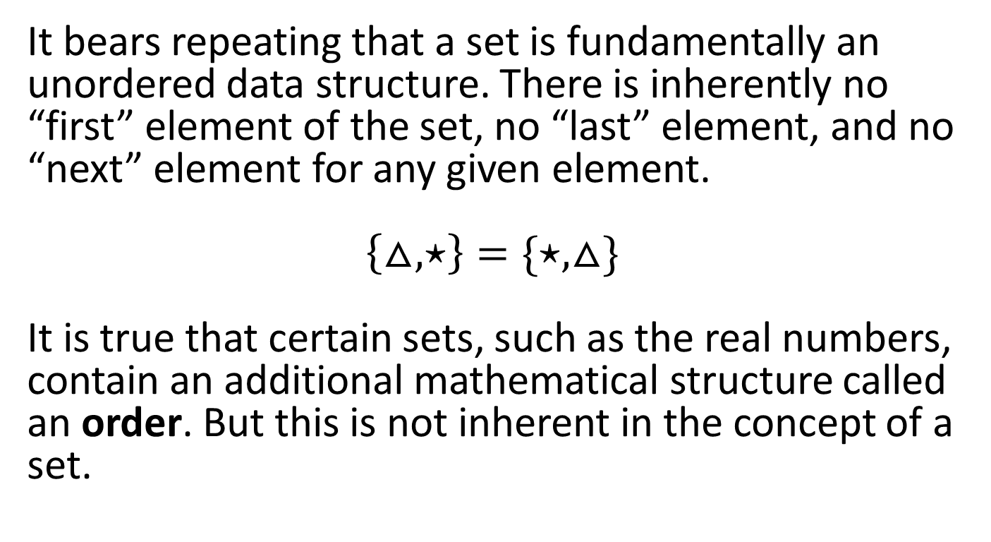
A set is an unordered data structure
It bears repeating that a set is fundamentally an unordered data structure. There is inherently no “first” element of the set, no “last” element, and no “next” element for any given element. $$\left\{△,⋆\right\}=\{⋆, △\}$$ It is true that certain sets, such as the real numbers, contain an additional mathematical structure called an order. But this is not inherent in the concept of a set.

Slide 4
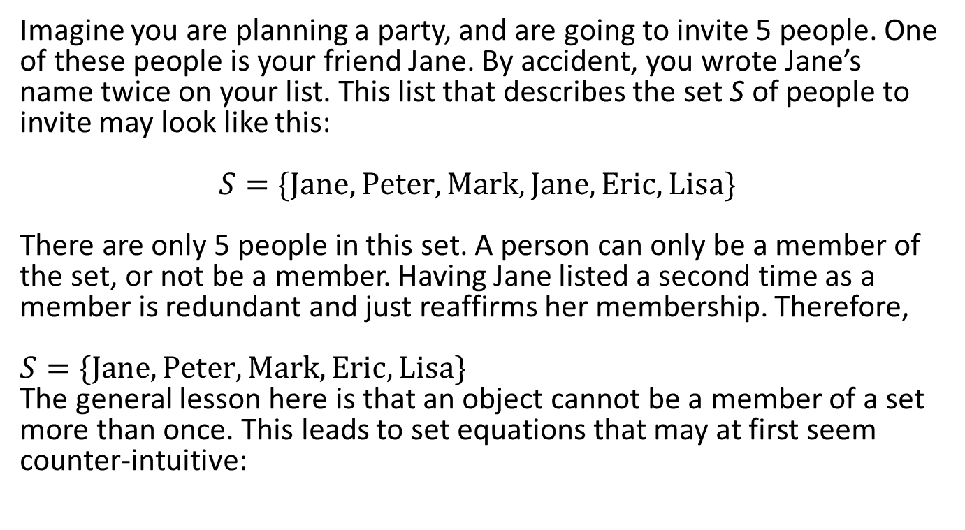
The members of a set are distinguishable objects
Imagine you are planning a party, and are going to invite 5 people. One of these people is your friend Jane. By accident, you wrote Jane’s name twice on your list. This list that describes the set S of people to invite may look like this: $$S=\{Jane, Peter, Mark, Jane,Eric,Lisa\}$$ There are only 5 people in this set. A person can only be a member of the set, or not be a member. Having Jane listed a second time as a member is redundant and just reaffirms her membership. Therefore, $$S=\{Jane, Peter, Mark, Eric,Lisa\}$$ The general lesson here is that an object cannot be a member of a set more than once. This leads to set equations that may at first seem counter-intuitive: $$\left\{△,△,△,△\right\}=\left\{△\right\}$$

Slide 5
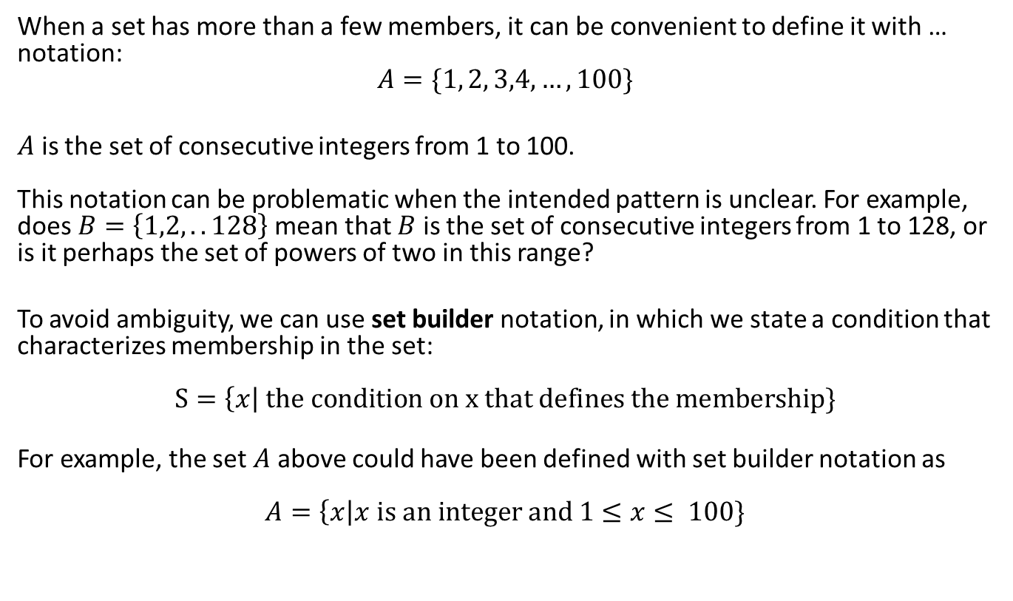
Other Ways of Defining Sets
When a set has more than a few members, it can be convenient to define it with … notation: $$A=\{1, 2, 3,4,…, 100\}$$
$A$ is the set of consecutive integers from 1 to 100. This notation can be problematic when the intended pattern is unclear. For example, does $B=\left\{1,2, .. 128\right\}$mean that $B$ is the set of consecutive integers from 1 to 128, or is it perhaps the set of powers of two in this range?
To avoid ambiguity, we can use set builder notation, in which we state a condition that characterizes membership in the set: $$S=\left\{x\right| the condition on x that defines the membership\}$$
For example, the set $A$ above could have been defined with set builder notation as $$A=\left\{x\right|x is an integer and 1≤x≤ 100\}$$

Slide 6
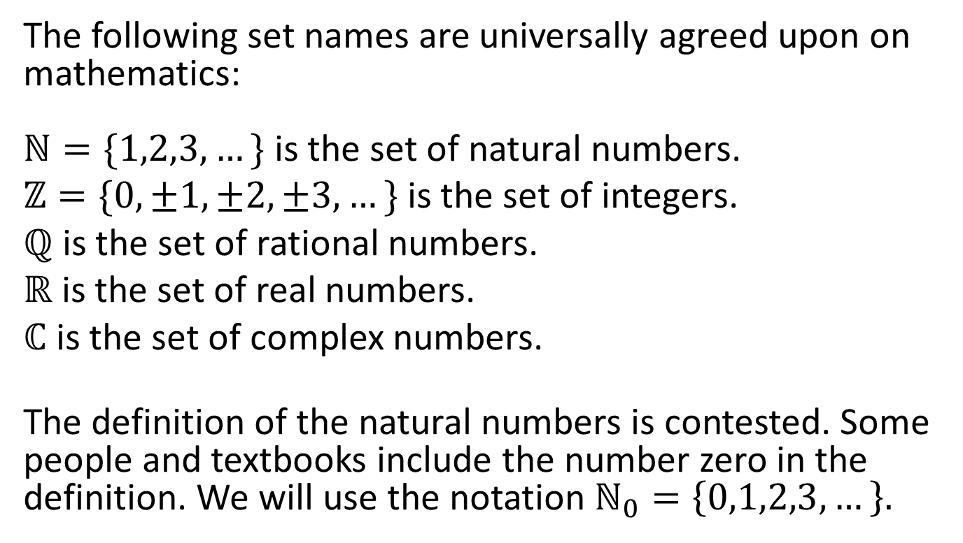
Names for Common Sets
The following set names are universally agreed upon on mathematics: $ℕ=\{1,2,3,…\}$ is the set of natural numbers.
$ℤ=\{0,±1,±2,±3,…\}$ is the set of integers.
$ℚ$ is the set of rational numbers.
$ℝ$ is the set of real numbers.
$ℂ$ is the set of complex numbers.
The definition of the natural numbers is contested. Some people and textbooks include the number zero in the definition. We will use the notation $ℕ_{0}=\left\{0,1,2,3,…\right\}.$

Slide 7
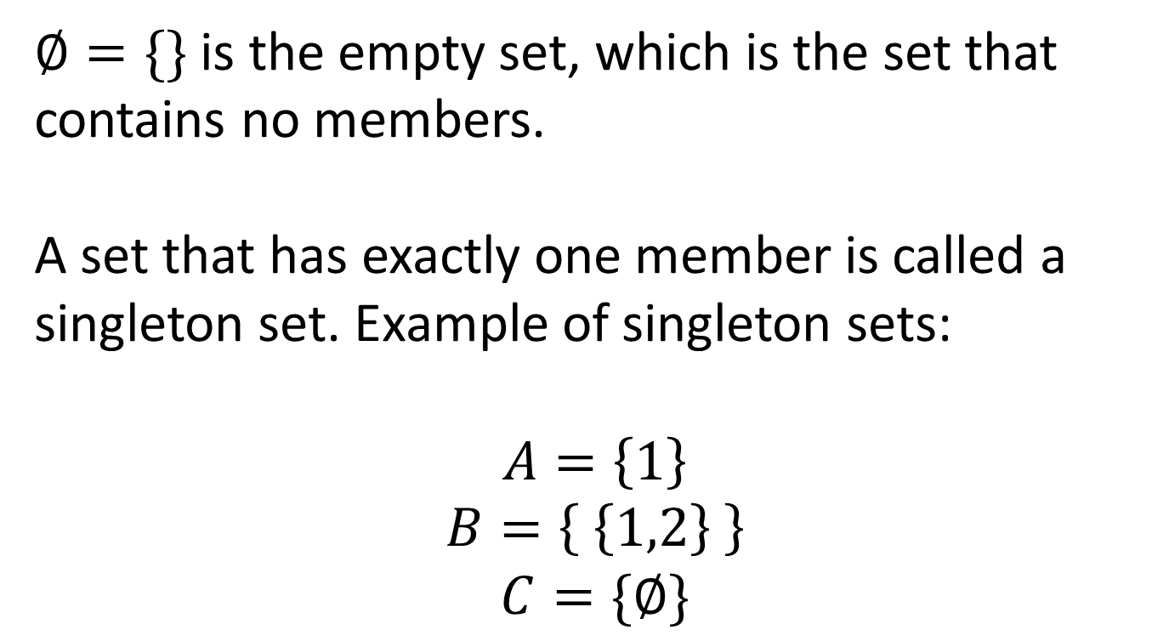
The empty set, singleton sets
$∅=\{\}$ is the empty set, which is the set that contains no members. A set that has exactly one member is called a singleton set. Example of singleton sets:
$$A=\left\{1\right\}$$
$$B=\left\{ \left\{1,2\right\} \right\}$$
$$C=\{∅\}$$

Slide 8
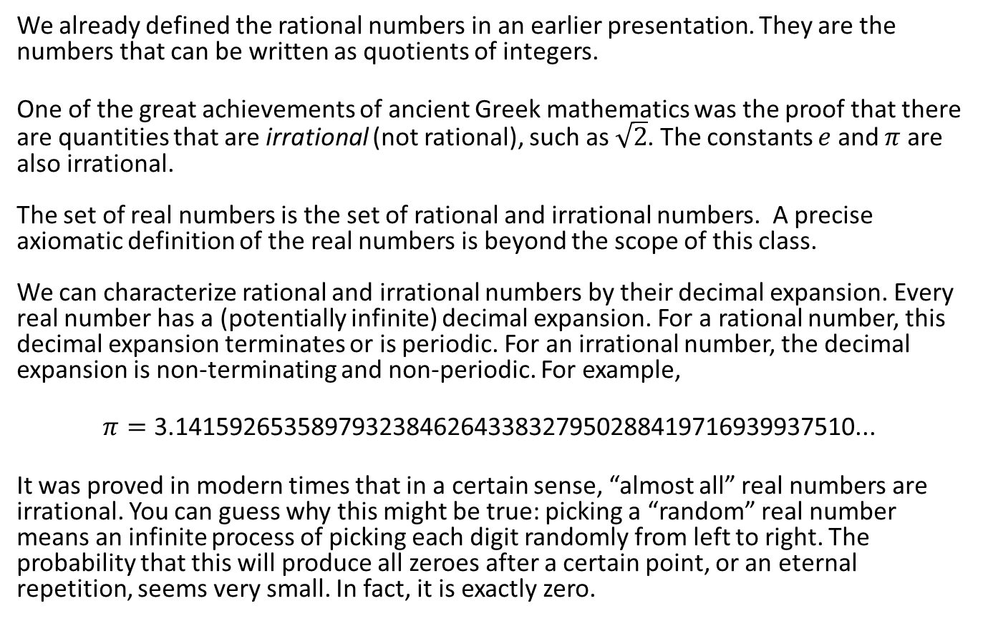
Rational vs Real Numbers
We already defined the rational numbers in an earlier presentation. They are the numbers that can be written as quotients of integers.
One of the great achievements of ancient Greek mathematics was the proof that there are quantities that are irrational (not rational), such as $\sqrt{2}$. The constants $e$ and $π$ are also irrational. The set of real numbers is the set of rational and irrational numbers. A precise axiomatic definition of the real numbers is beyond the scope of this class. We can characterize rational and irrational numbers by their decimal expansion. Every real number has a (potentially infinite) decimal expansion. For a rational number, this decimal expansion terminates or is periodic. For an irrational number, the decimal expansion is non-terminating and non-periodic. For example,
$$π=\text{3.14159265358979323846264338327950288419716939937510}\text{...}$$
It was proved in modern times that in a certain sense, “almost all” real numbers are irrational. You can guess why this might be true: picking a “random” real number means an infinite process of picking each digit randomly from left to right. The probability that this will produce all zeroes after a certain point, or an eternal repetition, seems very small. In fact, it is exactly zero.

Slide 9
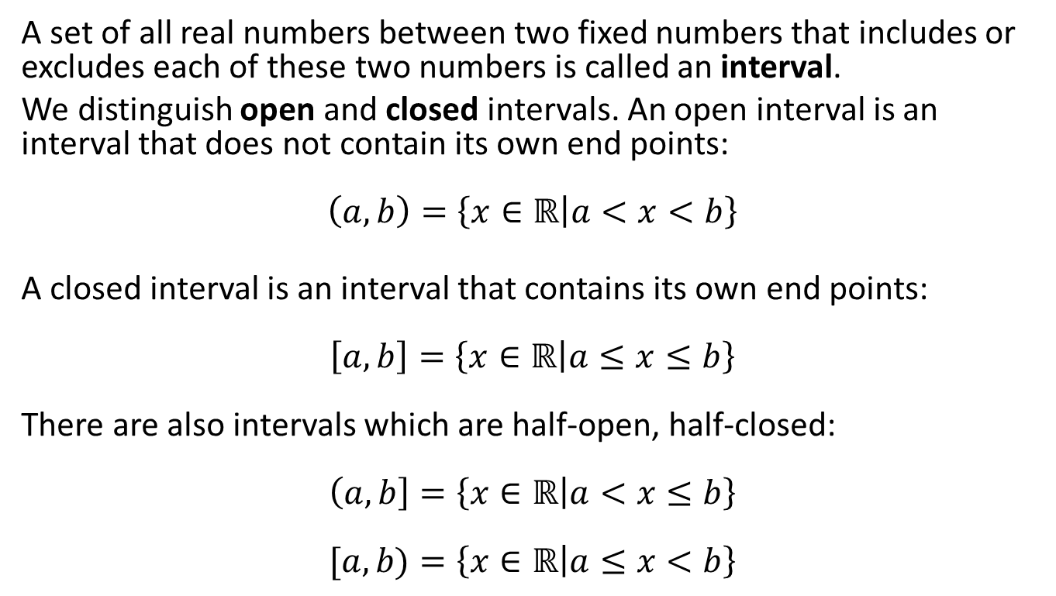
Interval notation
A set of all real numbers between two fixed numbers that includes or excludes each of these two numbers is called an interval.
We distinguish open and closed intervals. An open interval is an interval that does not contain its own end points: $$\left(a,b\right)=\left\{x∈ℝ | a<x<b\right\}$$
A closed interval is an interval that contains its own end points: $$\left[a,b\right]=\left\{x∈ℝ | a≤x≤b\right\}$$ There are also intervals which are half-open, half-closed: $$\left(a,b\right]=\left\{x∈ℝ | a<x≤b\right\}$$ $$[a,b)=\left\{x∈ℝ | a≤x<b\right\}$$

Slide 10
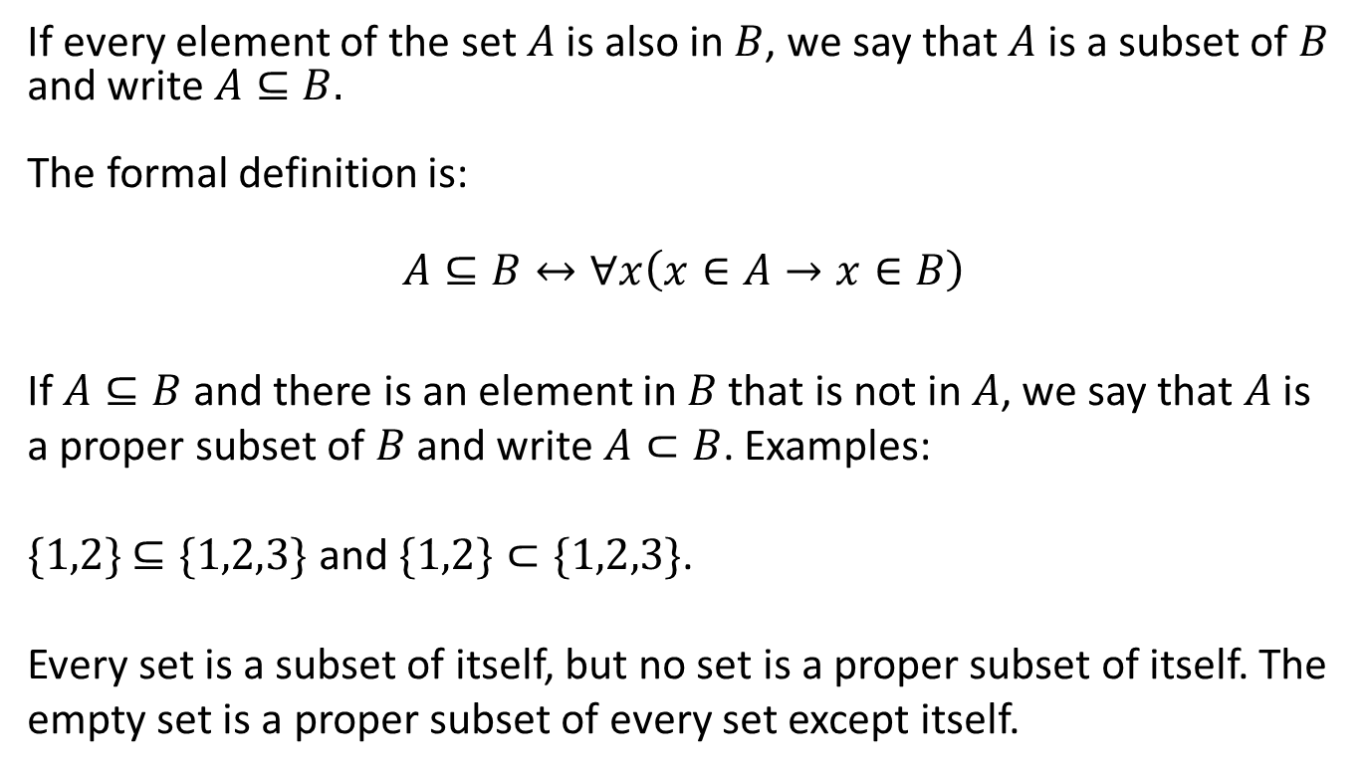
The Subset Relationship
If every element of the set $A$ is also in $B$, we say that $A$ is a subset of $B$ and write $A⊆B.$ The formal definition is:
$$A⊆B↔∀x\left(x∈A→x∈B\right)$$ If $A⊆B$and there is an element in $B$ that is not in $A$, we say that $A$ is a proper subset of $B$ and write $A⊂B$. Examples: $\{1,2\}$ $⊆\{1,2,3\}$ and $\{1,2\}⊂\{1,2,3\}$. Every set is a subset of itself, but no set is a proper subset of itself. The empty set is a proper subset of every set except itself.

Slide 11
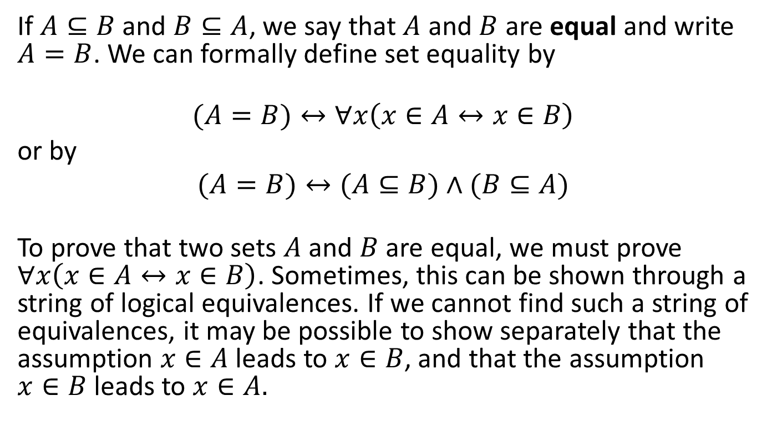
Set Equality
If $A⊆B$ and $B⊆A$, we say that $A$ and $B$ are equal and write $A=B$. We can formally define set equality by
$$(A=B)↔∀x\left(x∈A↔x∈B\right)$$
or by
$$(A=B)↔(A⊆B)∧(B⊆A)$$
To prove that two sets $A$ and $B$ are equal, we must prove $∀x\left(x∈A↔x∈B\right)$. Sometimes, this can be shown through a string of logical equivalences. If we cannot find such a string of equivalences, it may be possible to show separately that the assumption $x∈A$ leads to $x∈B$, and that the assumption $x∈B$ leads to $x∈A.$

Slide 12
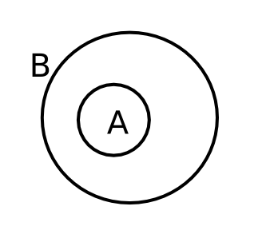
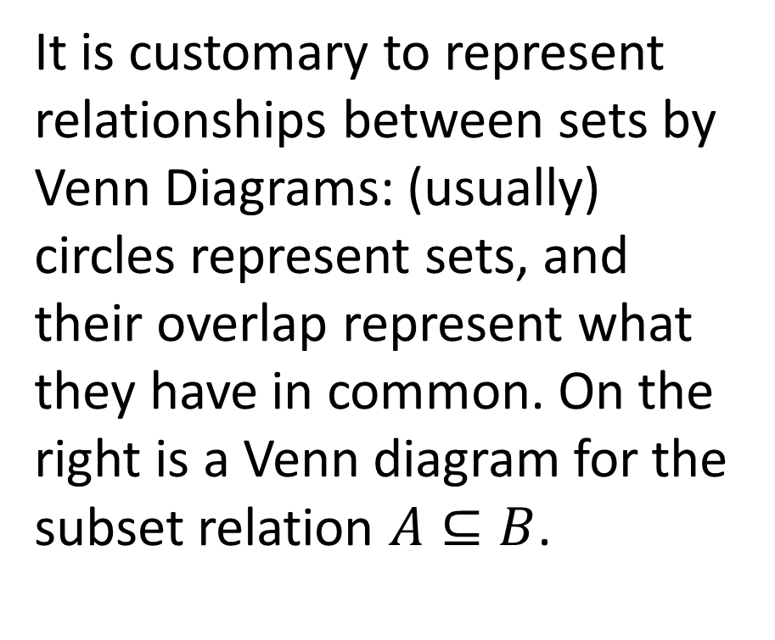
Venn Diagrams for subset relations
It is customary to represent relationships between sets by Venn Diagrams: (usually) circles represent sets, and their overlap represent what they have in common. On the right is a Venn diagram for the subset relation $A⊆B$.

Slide 13
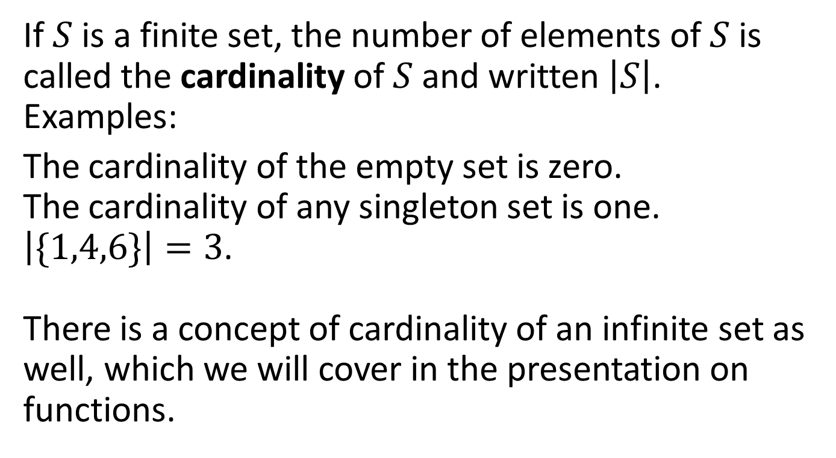
Cardinality
If $S$ is a finite set, the number of elements of $S$ is called the cardinality of $S$ and written $\left|S\right|$. Examples:
The cardinality of the empty set is zero. The cardinality of any singleton set is one. $\left|\{1,4,6\}\right|=3$. There is a concept of cardinality of an infinite set as well, which we will cover in the presentation on functions.

Slide 14
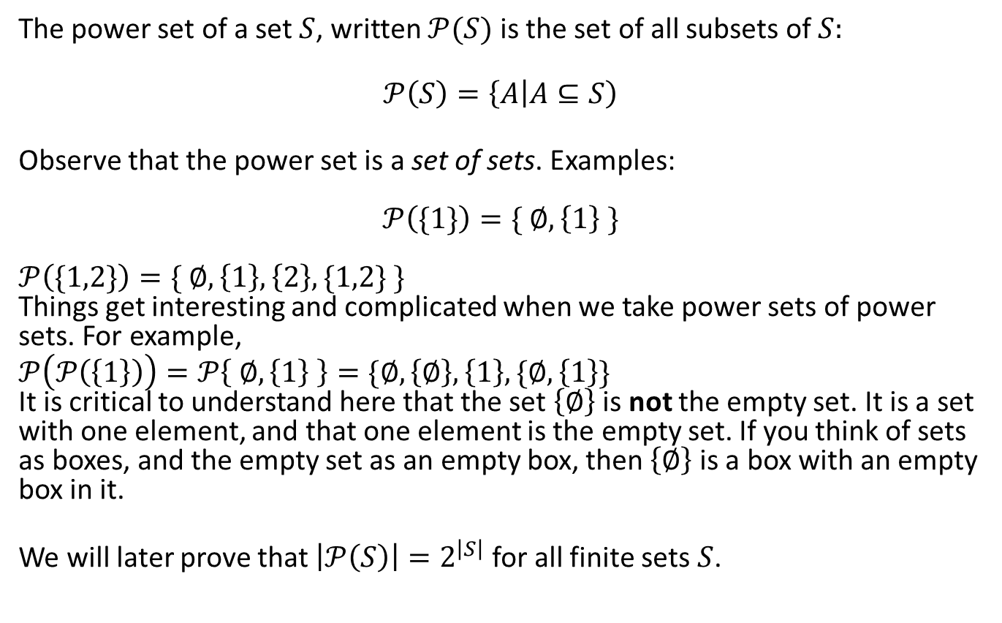
Power Sets
The power set of a set $S$, written $𝒫(S)$ is the set of all subsets of $S:$
$$𝒫\left(S\right)=\left\{A | A⊆S\right)$$
Observe that the power set is a set of sets. Examples: $$𝒫\left(\{1\}\right)=\{ ∅, \left\{1\right\} \}$$ $$𝒫\left(\{1,2\}\right)=\{ ∅, \left\{1\right\}, \left\{2\right\}, \{1,2\} \}$$ Things get interesting and complicated when we take power sets of power sets. For example, $$𝒫\left(𝒫\left(\left\{1\right\}\right)\right)=𝒫\left\{ ∅, \left\{1\right\} \right\}=\{∅,\left\{∅\right\}, \left\{1\right\}, \{∅,\left\{1\right\}\}$$
It is critical to understand here that the set $\left\{∅\right\}$ is not the empty set. It is a set with one element, and that one element is the empty set. If you think of sets as boxes, and the empty set as an empty box, then $\left\{∅\right\}$ is a box with an empty box in it.
We will later prove that $\left|𝒫\left(S\right)\right|=2^{\left|S\right|}$ for all finite sets $S$.

Slide 15
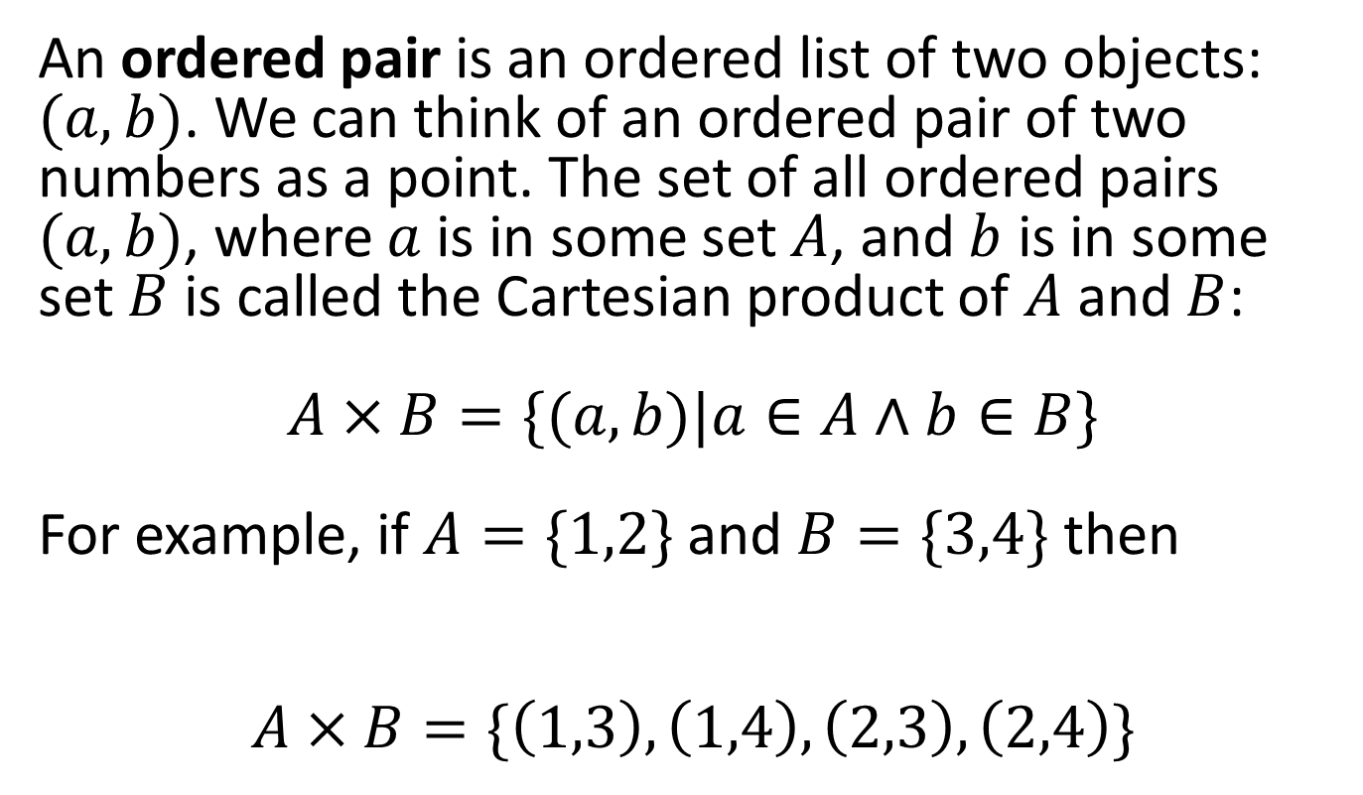
The Cartesian Product
An ordered pair is an ordered list of two objects: $(a,b)$. We can think of an ordered pair of two numbers as a point. The set of all ordered pairs $(a,b)$, where $a$ is in some set $A$, and $b$ is in some set $B$ is called the Cartesian product of $A$ and $B$: $$A×B=\{(a,b)|a∈A∧b∈B\}$$ For example, if $A=\{1,2\}$ and $B=\{3,4\}$ then
$$A×B=\{\left(1,3\right),\left(1,4\right),\left(2,3\right),\left(2,4\right)\}$$

Slide 16
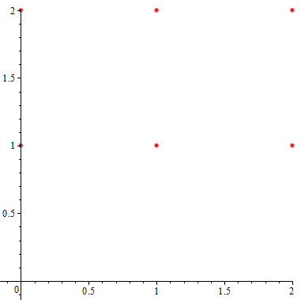
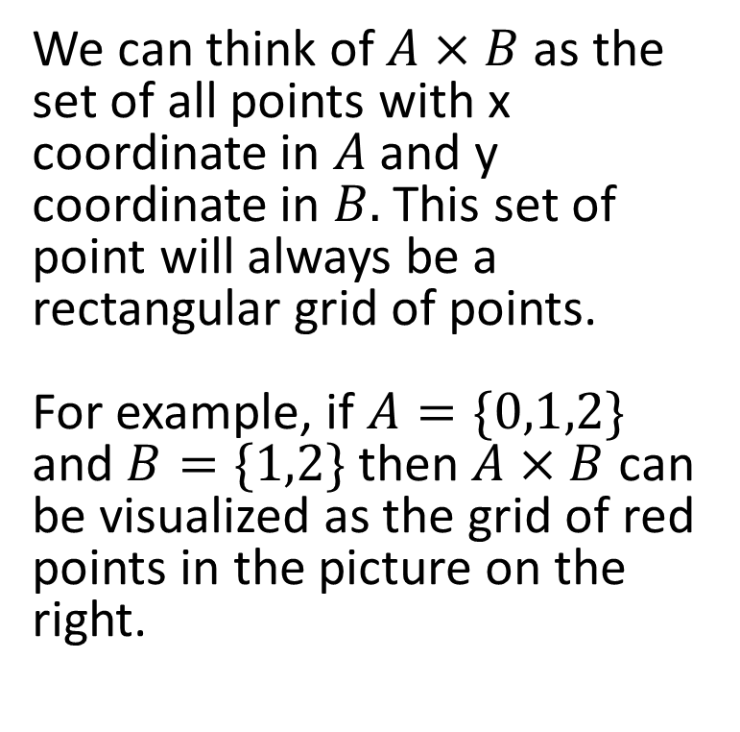
Visualization of the Cartesian Product
We can think of $A×B$ as the set of all points with x coordinate in $A$ and y coordinate in $B.$ This set of point will always be a rectangular grid of points. For example, if $A=\{0,1,2\}$ and $B=\{1,2\}$ then $A×B$ can be visualized as the grid of red points in the picture on the right.

Slide 17
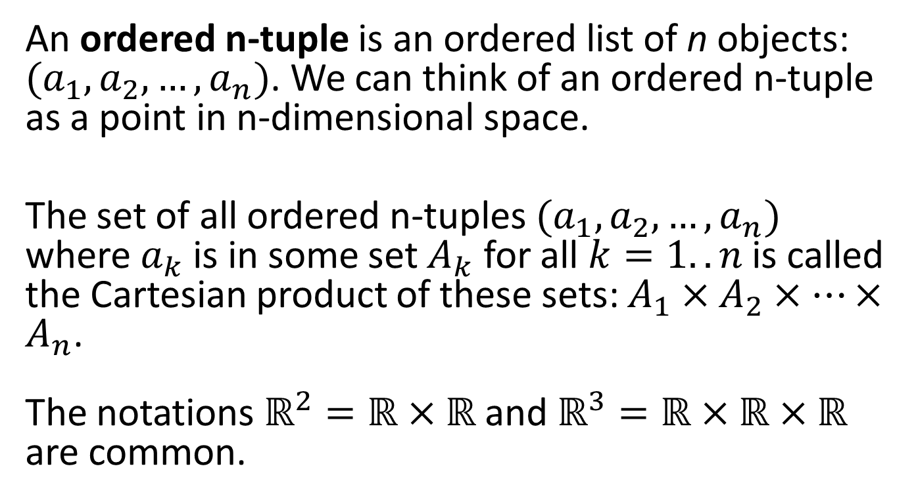
The Cartesian product of more than two sets
An ordered n-tuple is an ordered list of n objects: $(a_{1},a_{2},…,a_{n})$. We can think of an ordered n-tuple as a point in n-dimensional space.
The set of all ordered n-tuples $(a_{1},a_{2},…,a_{n})$ where $a_{k}$ is in some set $A_{k}$ for all $k=1..n$is called the Cartesian product of these sets: $A_{1}×A_{2}×…×A_{n}$. The notations $ℝ^{2}=ℝ×ℝ$ and $ℝ^{3}=ℝ×ℝ×ℝ$ are common.

Slide 18
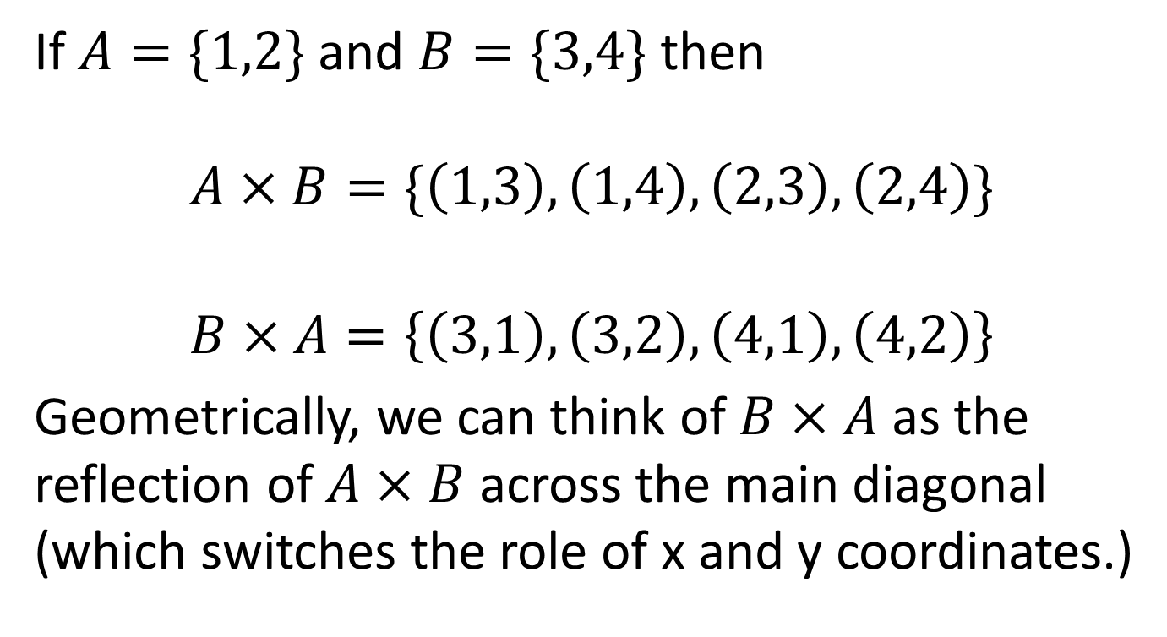
The Cartesian Product is not commutative!
If $A=\{1,2\}$ and $B=\{3,4\}$ then $$A×B=\{\left(1,3\right),\left(1,4\right),\left(2,3\right),\left(2,4\right)\}$$
$$B×A=\left\{\left(3,1\right),\left(3,2\right),\left(4,1\right),\left(4,2\right)\right\}$$ Geometrically, we can think of $B×A$ as the reflection of $A×B$ across the main diagonal (which switches the role of x and y coordinates.)

